Slide 1
Prep
Open:
https://github.com/emilybache/GildedRose-Refactoring-Kata/blob/master/GildedRoseRequirements.txt
https://github.com/approvals/ApprovalTests.Java
https://github.com/InnovatingTeams/provable-refactorings/blob/master/recipes/micro-step-helpers/add-explicit-return/cpp.md
https://github.com/RefactoringCombos/ArlosCommitNotation
Git
git rev-list --count master..head

Slide 2
From 0% to Cleanly Refactored 100% Tested Code
Notes:
In this guided demo, we are going to look at 3 different techniques that are remarkably powerful in combination to cut through legacy code without having to go through the bother of reading or understanding it.
The techniques are:
Combination Testing: to get 100% test coverage quickly
Code Coverage as guidance: to help us make decisions about inputs and deletion
Provable Refactorings: to help us change code without having to worry about it.
In combination, these 3 techniques can quickly make impossible tasks trivial.
Will will be doing this on the Gilded Rose Kata, https://github.com/emilybache/GildedRose-Refactoring-Kata
It is extra beneficial if you try it out yourself first so you can see how your implementation would differ.

Slide 3
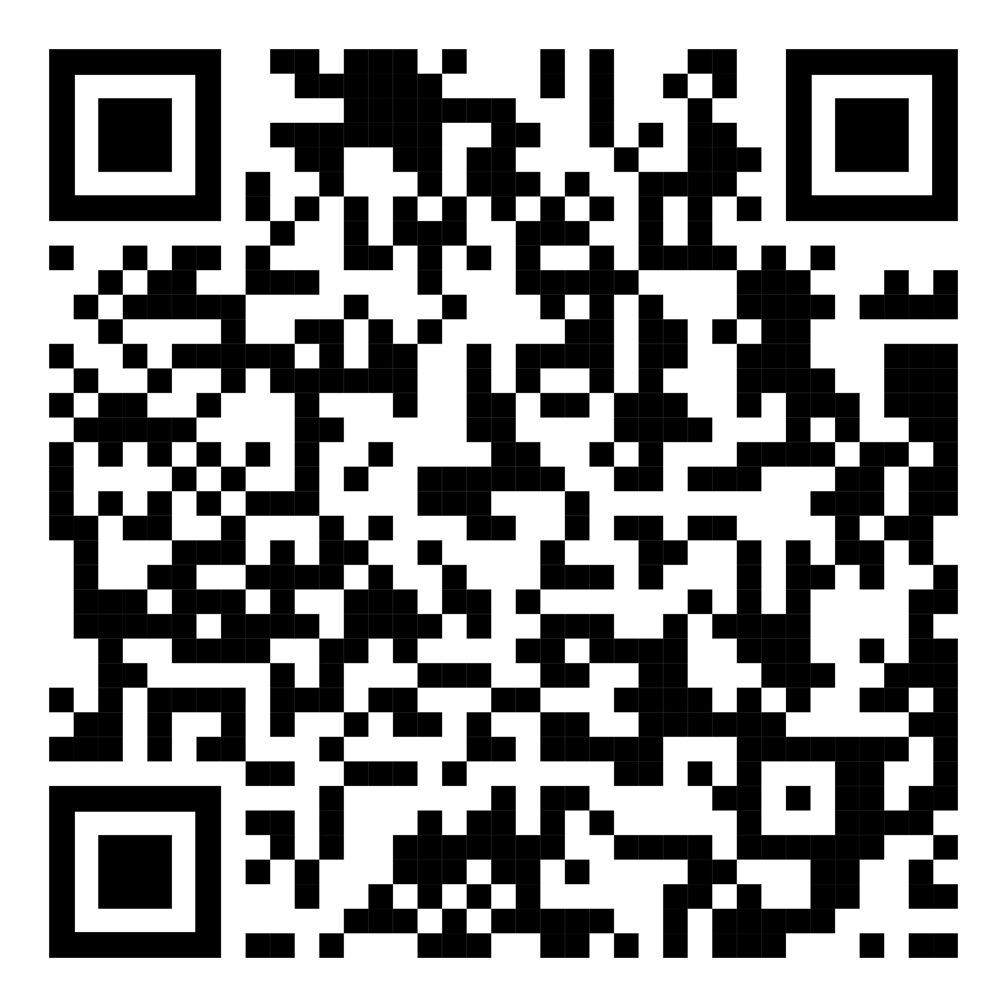
https://github.com/isidore/Talks/blob/master/CuttingCodeQuickly.md

Slide 4
github.com/emilybache/GildedRose-Refactoring-Kata

Slide 5
Feature Request: "Conjured" items degrade in Quality twice as fast as normal items

Slide 6
“Give me 6 hours to chop down a tree and I will spend the first 4 sharpening the axe.
Abraham Lincoln

Slide 7
“Make the change easy, Then make the easy change. Warning: the first part might be hard”
Kent beck

Slide 8
The difference between a good programmer & a great programmer is that the great programmers are extremely lazy

Slide 9
Arlo’s Commit Notation
Risk Prefix | meaning
. | Provable
- | Tested
! | Single Action
@ | Other
Action Prefix | meaning
e | Environment (non-code)
d | Documentation
t | Tests Only
r | Refactoring
F | Feature
B | Bug
Examples
. r rename variable
! B fixed spelling on label

Slide 10
Arlo’s Commit Notation
Risk Prefix | meaning
. | Provable
- | Tested
! | Single Action
@ | Other
Action Prefix | meaning
e | Environment (non-code)
d | Documentation
t | Tests Only
r | Refactoring
F | Feature
B | Bug
Examples
. r rename variable
! B fixed spelling on label

Slide 11
Arlo’s Commit Notation
Risk Prefix | meaning
. | Provable
- | Tested
! | Single Action
@ | Other
Action Prefix | meaning
e | Environment (non-code)
d | Documentation
t | Tests Only
r | Refactoring
F | Feature
B | Bug
Examples
. r rename variable
! B fixed spelling on label

Slide 12
Arlo’s Commit Notation
Risk Prefix | meaning
. | Provable
- | Tested
! | Single Action
@ | Other
Action Prefix | meaning
e | Environment (non-code)
d | Documentation
t | Tests Only
r | Refactoring
F | Feature
B | Bug
Examples
. r rename variable
! B fixed spelling on label

Slide 13
Arlo’s Commit Notation
Risk Prefix | meaning
. | Provable
- | Tested
! | Single Action
@ | Other
Action Prefix | meaning
e | Environment (non-code)
d | Documentation
t | Tests Only
r | Refactoring
F | Feature
B | Bug
Examples
. r rename variable
! B fixed spelling on label

Slide 14
1. Test
Let’s write a few hundred tests

Slide 15
2. Lift-Up Conditional Refactoring
Lift and Separate…

Slide 16
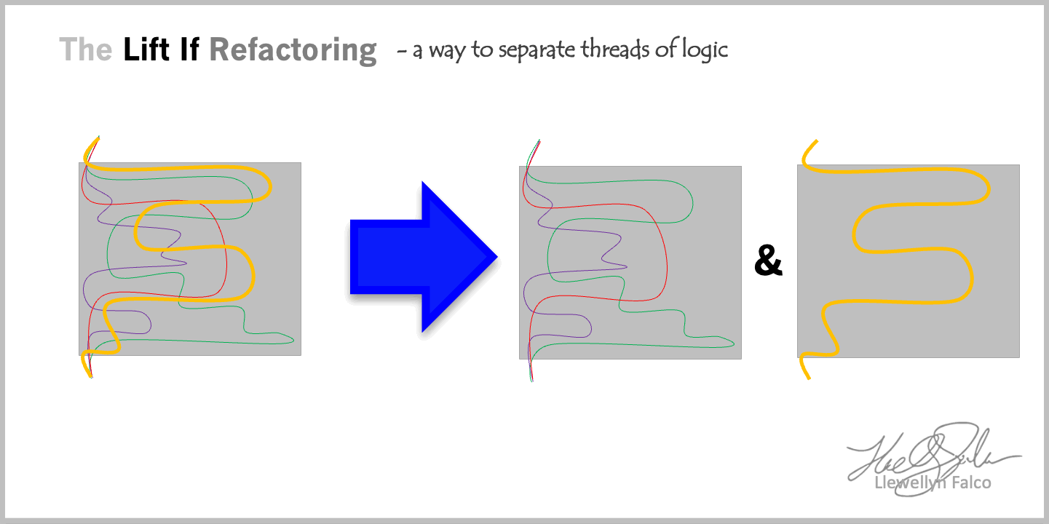

Slide 17
3. Split to Classes
To each there own…

Slide 18
4. Add New functionality
Make it easy, do the easy thing

Slide 19
https://github.com/isidore/Talks/blob/master/CuttingCodeQuickly.md

Slide 20

Thanks!
Please connect on
LinkedIn & Twitter
ANY QUESTIONS?
You can find me at:
@LlewellynFalco
llewellynfalco.blogspot.com
Presentation template by SlidesCarnival

Slide 21
SlidesCarnival icons are editable shapes.
This means that you can:
Resize them without losing quality.
Change fill color and opacity.
Isn’t that nice? :)
Examples:

